Slide 1





Asynchronous Programming with Python

Slide 2

Hello!
I am Ikhwan Rizqy Nurzaman
Software Developer
You can find me at linkedin.com/in/ikhwanrnurzaman

Slide 3
Synchronous System
Process requests one-by-one

Slide 4


Client request data to server
Server handles client’s request
Server sends resources to client
Server get resources

Slide 5
Main problem
Doesn’t use computer resources fully
There are a lot of time wasted in waiting for the response

Slide 6







Asynchronous System
In a Nutshell

Slide 7
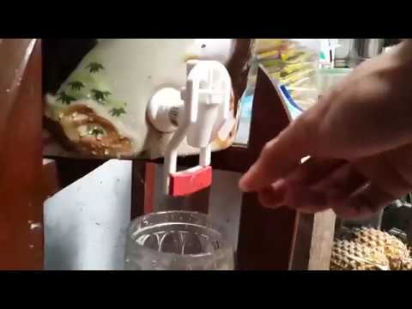

Slide 8
Server handles client’s request
Client request data to server
Server get resources
Server sends resources to client

Slide 9
Asynchronous with asyncio
Python3.7
asyncio
async/await
Coroutines
Specialized python generator which can be paused
Event Loop
Loop where coroutines take turn to executed

Slide 10

Hands-on

Slide 11
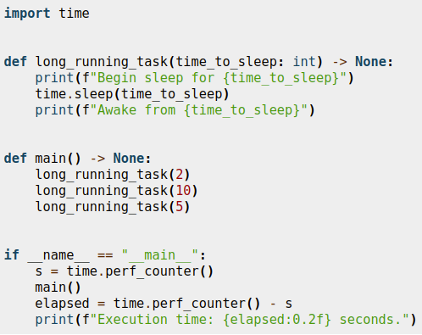

Slide 12
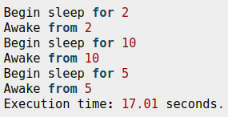

Slide 13
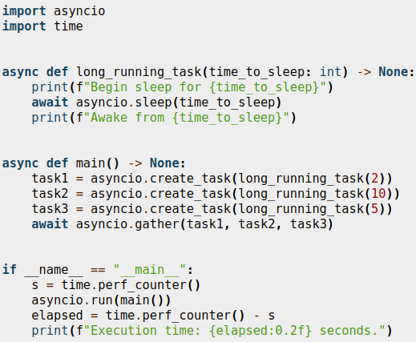

Slide 14
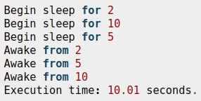

Slide 15
Client
(Data Collector)
Server
Data Snapshot
Server (Data Updater)
Database

Slide 16
Coroutine 1
...
await get_data()
...
Coroutine 1
Coroutine 2
...
await redis.xread(...)
...
Coroutine 3
Coroutine 2
Coroutine 3
...
await asyncio.sleep(3)
...

Slide 17

Thanks!
Any questions?

